Slide 1
Nhóm 7 Thành viên: Vũ THường Đạt – 20215031 Bùi Tá Đức – 20215035 Nghiêm Xuân diện – 20215007 Nguyễn Công đoàn - 20215034
Topic 1: Visualization of operations on tree data structures

Slide 2
Problem statement
-GUI
-Design: + main menu
+ Visualization: Create: Create a new empty tree
Insert: Add the new node with a specified value as a child of the specified parent
node
Delete: Delete the node from the tree
Update: Change the node with current value to new value
Traverse: Traverse all nodes in the tree (highlight the current node in each step of
traverse)
Search: Search for the node value in the tree

Slide 3
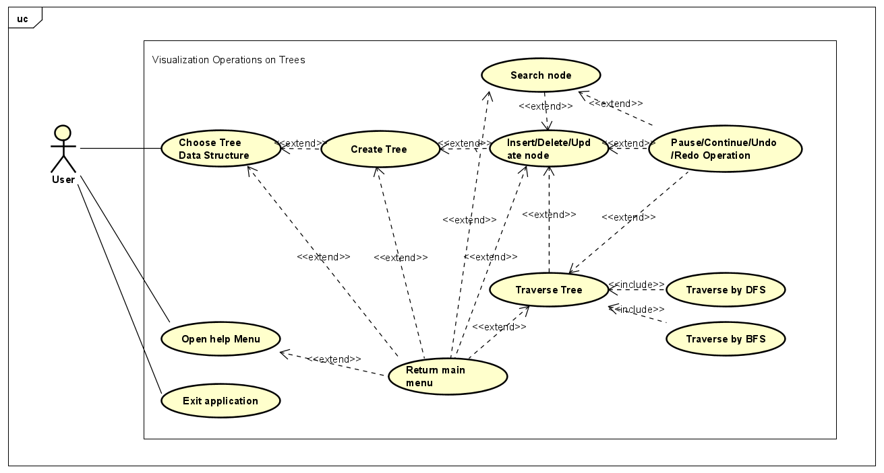
Use case diagram

Slide 4
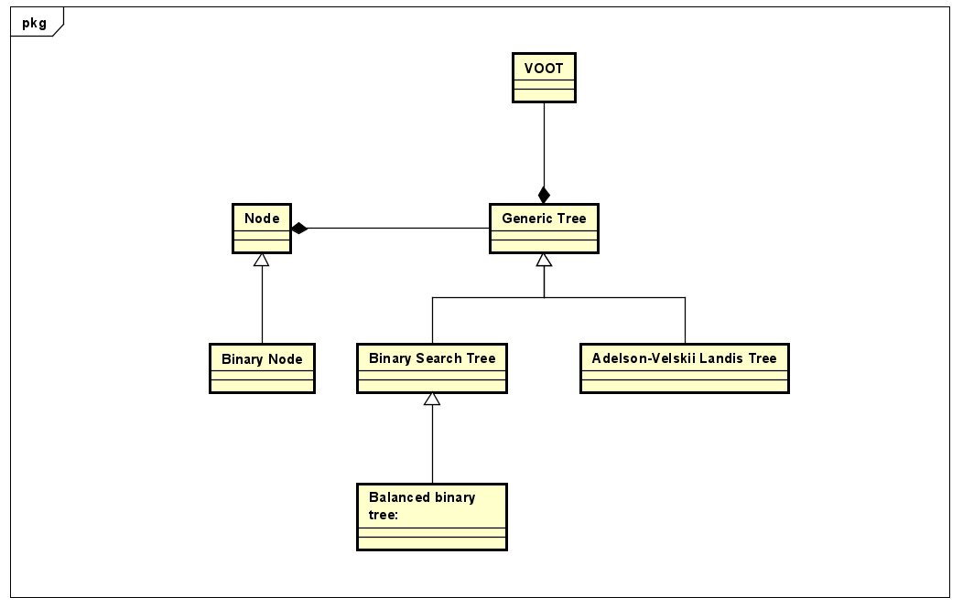
Class diagram

Slide 5
